Slide 1
Cloud Computing
Introduction to Cloud Computing

Slide 2
Agenda
What is Cloud Computing ?
  Different perspectives
  Properties and characteristics
  Benefits from cloud computing
Service and deployment models
  Three service models
  Four deployment models

Slide 3
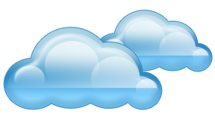
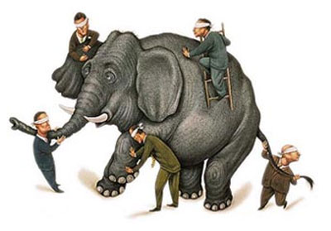
What is Cloud computing ?
Properties and characteristics

Slide 4
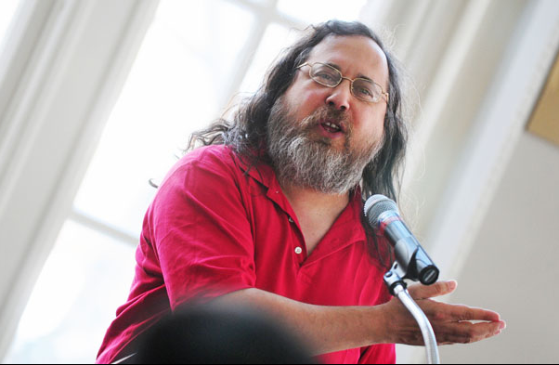
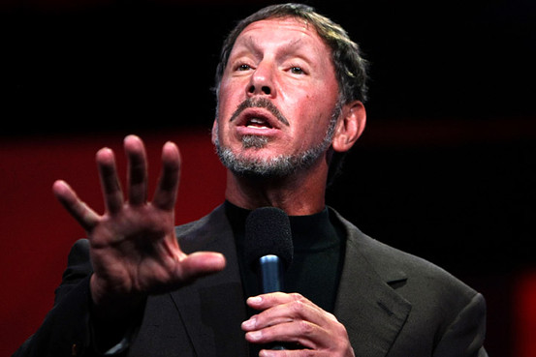
Cloud Disclaimers
Talk from Oracle CEO Larry Ellison
  We’ve redefined Cloud Computing to include everything that we already do. I don’t understand what we would do differently other than change the wording of some of our ads.
Talk from Rich Stallman
  It's stupidity. It's worse than stupidity: it's a marketing hype campaign. Somebody is saying this is inevitable – and whenever you hear somebody saying that, it's very likely to be a set of businesses campaigning to make it true.

Slide 5
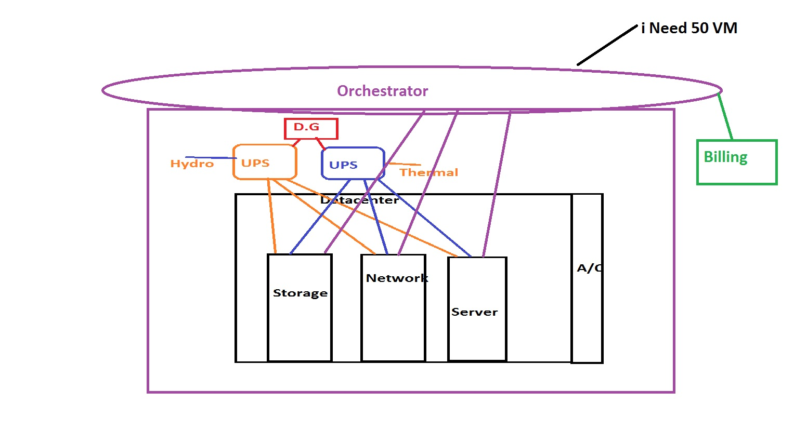
Whats Behind the Cloud?

Slide 6

In Our Humble Opinion
Cloud computing is a paradigm of computing, a new way of thinking about IT industry but not any specific technology.
  Central ideas
    Utility Computing
    SOA - Service Oriented Architecture
    SLA - Service Level Agreement
  Properties and characteristics - 2AMPS
    High availability and reliability
    High accessibility and portability
    High manageability and interoperability
    High performance and optimization
    High scalability and elasticity
  Enabling techniques
    Hardware virtualization
    Parallelized and distributed computing
    Web service

Slide 7

Central Ideas
Utility Computing
SOA + SLA
Don’t tell me details!!
I DON’T CARE!!

Slide 8

Central Ideas
Utility Computing
SOA + SLA
Perspective from user :
  Users do not care about how the works are done
    Instead, they only concern about what they can get
  Users do not care about what the provider actually did
    Instead, they only concern about their quality of service
  Users do not want to own the physical infrastructure
    Instead, they only want to pay as many as they used
What dose user really care ?
  They only care about their “Service”

Slide 9
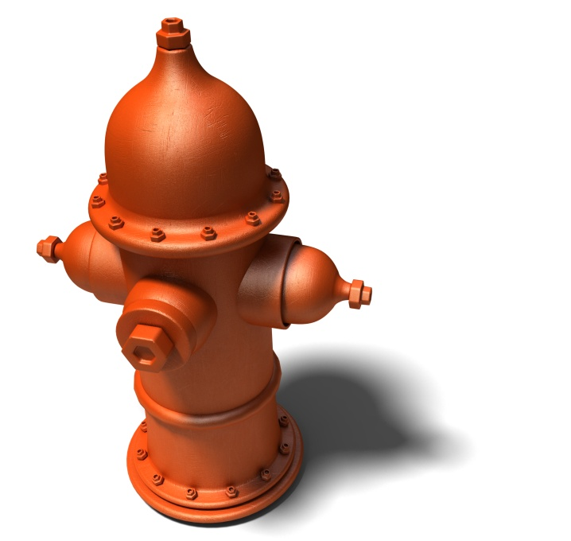
Utility Computing
Utility Computing
SOA + SLA
One service provisioning model
  Service provider makes computing resources and infrastructure management available to the customer as needed, and charges them for specific usage rather than a flat rate.
  Like other types of on-demand computing , the utility model seeks to maximize the efficient use of resources and/or minimize associated costs.

Slide 10
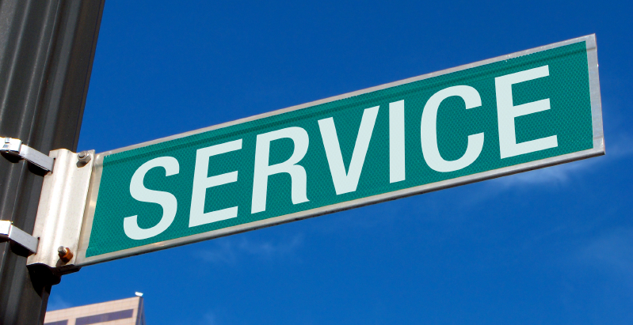
What Is Service?
Utility Computing
SOA + SLA
Service is what you connect together using Web Services.
Service is the endpoint of a connection.
Functionalities of service :
  A service should be well-defined
  A service should be self-contained
  A service should not depend on the context or state of other services.

Slide 11
What Is Web Service?
Utility Computing
SOA + SLA
Definition :
  Web service is self-describing and stateless modules that perform discrete units of work and are available over the network
  Web service providers offer APIs that enable developers to exploit functionality over the Internet, rather than delivering full-blown applications
Web Services Description Language (WSDL) :
  Expressed in XML which include both data type and messages
  Four types of operations :
    One-way - Messages sent without a reply required
    Request & response - Sending and replying messages
    Solicit response - A request for a response
    Notification - Messages sent to multiple receivers

Slide 12
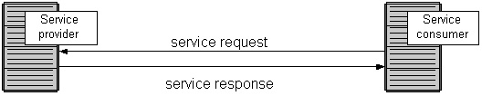
Service Oriented Architecture
Utility Computing
SOA + SLA
Definition
  Service Oriented Architecture (SOA) is essentially a collection of services which communicate with each other
  Contain a flexible set of design principles used during the phases of systems development and integration
  Provide a loosely-integrated suite of services that can be used within multiple business domains
Approach
  Usually implemented by Web Service model

Slide 13

Quality Of Service
Utility Computing
SOA + SLA
Original definition
  Quality of Service (QoS) is a set of technologies for managing network traffic in a cost effective manner to enhance user experiences for home and enterprise environments.
Now QoS becomes to a broad term
that is used following areas :
  Customer care evaluations
  Technological evaluations

Slide 14
Quality Of Service
Utility Computing
SOA + SLA
Customer care evaluations
  QoS is usually measured in terms of issues that have a direct
  impact on the experience of the customer
  Only issues that produce a negative effect on the goods and
  services received by the customer come under scrutiny
Technological evaluations
  QoS has to do with the efficient operation of various systems
  This can lead to adjusting procedures or adapting software programs and code to achieve the desired effect while making a more efficient use of available resources

Slide 15

Service Level Agreement
Utility Computing
SOA + SLA
Definition
  A service-level agreement (SLA) is a contract between a network service provider and a customer that specifies, usually in measurable terms (QoS), what services the network service provider will furnish
Common content in contract
  Performance guarantee metrics
    Up-time and down-time ratio
    System throughput
    Response time
  Problem management detail
  Penalties for non-performance
  Documented security capabilities

Slide 16
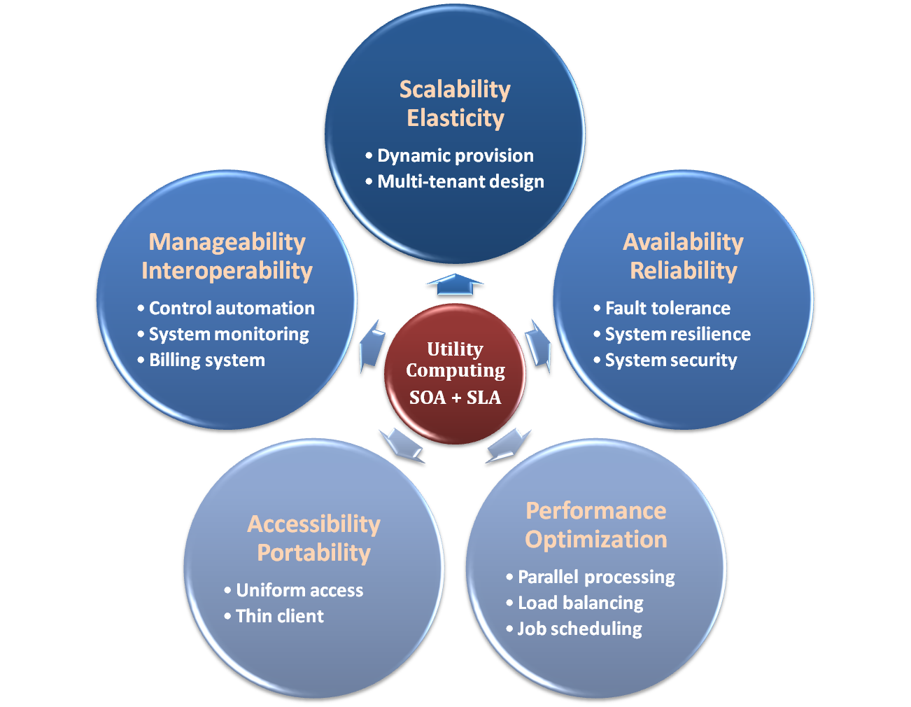

Properties and Characteristics

Slide 17
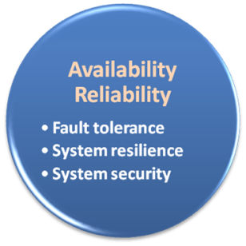

Availability & Reliability
Data Never Loss
Machine Never Fail

Slide 18
Availability & Reliability
What is availability ?
  The degree to which a system, subsystem, or equipment is in a specified operable and committable state at the start of a mission, when the mission is called for at an unknown time.
  Cloud system usually require high availability
    Ex. “Five Nines” system would statistically provide 99.999% availability
What is reliability ?
  The ability of a system or component to perform its required functions under stated conditions for a specified period of time.
But how to achieve these properties ?
  Fault tolerance system
  Require system resilience
  Reliable system security

Slide 19
Fault Tolerance
What is fault tolerant system ?
  Fault-tolerance is the property that enables a system to continue operating properly in the event of the failure of some of its components.
  If its operating quality decreases at all, the decrease is proportional to the severity of the failure, as compared to a naively-designed system in which even a small failure can cause total breakdown.
Four basic characteristics :
  No single point of failure
  Fault detection and isolation to the failing component
  Fault containment to prevent propagation of the failure
  Availability of reversion modes

Slide 20
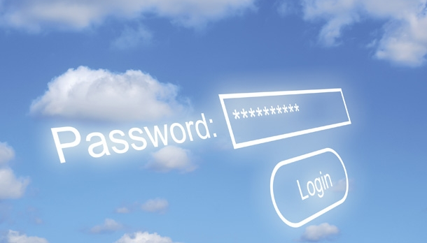
System Security
Security issue in Cloud Computing :
  Cloud security is an evolving sub-domain of computer security, network security, and, more broadly, information security.
  It refers to a broad set of policies, technologies, and controls deployed to protect data, applications, and the associated infrastructure of cloud computing.

Slide 21
System Security
Important security and privacy issues :
  Data Protection
    To be considered protected, data from one customer must be properly segregated from that of another.
  Identity Management
    Every enterprise will have its own identity management system to control access to information and computing resources.
  Application Security
    Cloud providers should ensure that applications available as a service via the cloud are secure.
  Privacy
    Providers ensure that all critical data are masked and that only authorized users have access to data in its entirety.

Slide 22
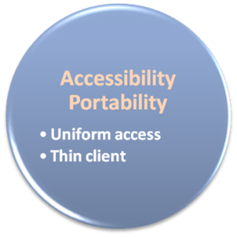

Accessibility & Portability
Anyone !
Anytime !
Anywhere !

Slide 23
Accessibility & Portability
What is accessibility ?
  Accessibility is a general term used to describe the degree to which a product, device, service, or environment is accessible by as many people as possible.
What is service portability ?
  Service portability is the ability to access services using any devices, anywhere, continuously with mobility support and dynamic adaptation to resource variations.
But how to achieve these properties ?
  Uniform access
  Thin client

Slide 24
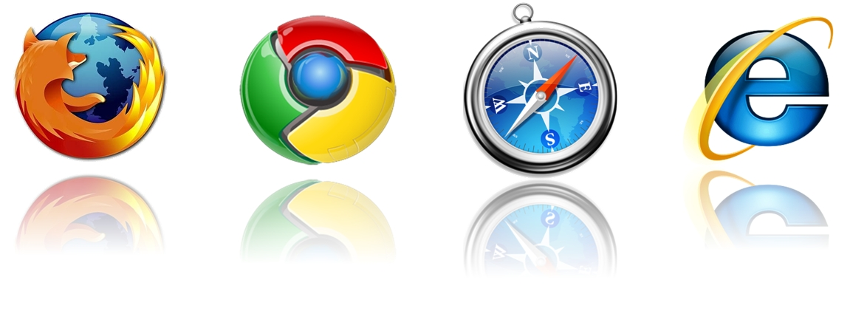
Uniform Access
How do users access cloud services ?
  Cloud provider should provide their cloud service by means of widespread accessing media. In other word, users from different operating systems or other accessing platforms should be able to directly be served.
  Nowadays, web browser technique is one of the most widespread platform in almost any intelligent electronic devices. Cloud service take this into concern, and delivery their services with web-based interface through the Internet.

Slide 25
Thin Client
What is thin client ?
  Thin client is a computer or a computer program which depends heavily on some other computer to fulfill its traditional computational roles. This stands in contrast to the traditional fat client, a computer designed to take on these roles by itself.
Characteristics :
  Cheap client hardware
    While the cloud providers handle several client sessions at once, the clients can be made out of much cheaper hardware.
  Diversity of end devices
    End user can access cloud service via plenty of various electronic devices, which include mobile phones and smart TV.
  Client simplicity
    Client local system do not need complete operational functionalities.

Slide 26
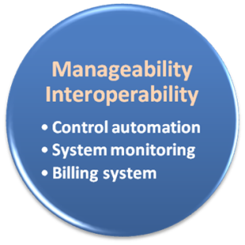

Manageability & Interoperability
I Want Full Control !!

Slide 27
Manageability & Interoperability
What is manageability ?
  Enterprise-wide administration of cloud computing systems. Systems manageability is strongly influenced by network management initiatives in telecommunications.
What is interoperability ?
  Interoperability is a property of a product or system, whose interfaces are completely understood, to work with other products or systems, present or future, without any restricted access or implementation.
But how to achieve these properties ?
  System control automation
  System state monitoring

Slide 28
Control Automation
Four functional areas :
  Self-Configuration
    Automatic configuration of components.
  Self-Healing
    Automatic discovery, and correction of faults.
  Self-Optimization
    Automatic monitoring and control of resources to ensure the optimal functioning with respect to the defined requirements.
  Self-Protection
    Proactive identification and protection from arbitrary attacks.

Slide 29

System Monitoring
What is system monitor ?
  A System Monitor in systems engineering is a process within a distributed system for collecting and storing state data.
What should be monitored in the Cloud ?
  Physical and virtual hardware state
  Resource performance metrics
  Network access patterns
  System logs
  … etc
Anything more ?
  Billing system

Slide 30

Billing System
Billing System in Cloud
  Users pay as many as they used.
  Cloud provider must first determine the list of service usage price.
  Cloud provider have to record the resource or service usage of each user, and then charge users by these records.
How can cloud provider know users’ usage ?
  Get those information by means of monitoring system.
  Automatically calculate the total
  amount of money which user
  should pay. And automatically
  request money from use’s banking
  account.

Slide 31
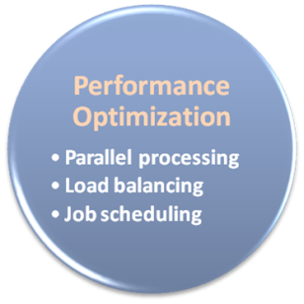

Performance & Optimization
High Performance
Improvement

Slide 32
Performance & Optimization
Performance guarantees ??
  As the great computing power in cloud, application performance should be guaranteed.
  Cloud providers make use of powerful infrastructure or other underlining resources to build up a highly performed and highly optimized environment, and then deliver the complete services to cloud users.
But how to achieve this property ?
  Parallel computing
  Load balancing
  Job scheduling

Slide 33
Parallel Processing
Parallel Processing
  Parallel processing is a form of computation in which many calculations are carried out simultaneously, operating on the principle that large problems can often be divided into smaller ones, which are then solved concurrently.
Parallelism in different levels :
  Bit level parallelism
  Instruction level parallelism
  Data level parallelism
  Task level parallelism

Slide 34
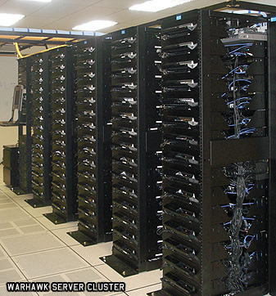
Parallel Processing
Hardware approaches
  Multi-core computer
  Symmetric multi-processor
  General purpose graphic processing unit
  Vector processor
  Distributed computing
    Cluster computing
    Grid computing
Software approaches
  Parallel programming language
  Automatic parallelization

Slide 35

Load Balancing
What is load balancing ?
  Load balancing is a technique to distribute workload evenly across two or more computers, network links, CPUs, hard drives, or other resources, in order to get optimal resource utilization, maximize throughput, minimize response time, and avoid overload.
Why should be load balanced ?
  Improve resource utilization
  Improve system performance
  Improve energy efficiency
Unbalanced

Slide 36
Job Scheduling
What is job scheduler ?
  A job scheduler is a software application that is in charge of unattended background executions, commonly known for historical reasons as batch processing.
What should be scheduled in Cloud ?
  Computation intensive tasks
  Dynamic growing and shrinking tasks
  Tasks with complex processing dependency
How to approach ?
  Use pre-defined workflow
  System automatic configuration

Slide 37
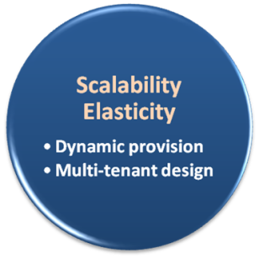

Scalability & Elasticity
Give me the world
without limitation!!

Slide 38
Scalability & Elasticity
What is scalability ?
  A desirable property of a system, a network, or a process, which indicates its ability to either handle growing amounts of work in a graceful manner or to be readily enlarged.
What is elasticity ?
  The ability to apply a quantifiable methodology that allows for the basis of an adaptive introspection with in a real time infrastructure.
But how to achieve these properties ?
  Dynamic provisioning
  Multi-tenant design

Slide 39
Multi-tenant Design
What is multi-tenant design ?
  Multi-tenant refers to a principle in software architecture where a single instance of the software runs on a server, serving multiple client organizations.
  With a multi-tenant architecture, a software application is designed to virtually partition its data and configuration thus each client organization works with a customized virtual application instance.
Client oriented requirements :
  Customization
    Multi-tenant applications are typically required to provide a high degree of customization to support each target organization's needs.
  Quality of service
    Multi-tenant applications are expected to provide adequate levels of security and robustness.

Slide 40

Benefits From Cloud
Cloud computing brings many benefits :
  For the market and enterprises
    Reduce initial investment
    Reduce capital expenditure
    Improve industrial specialization
    Improve resource utilization
  For the end user and individuals
    Reduce local computing power
    Reduce local storage power
    Variety of thin client devices in daily life

Slide 41

For End User and Individual

Slide 42
Reduce Local Computing Power
Traditional local computing power requirement :
  One need to buy your own personal computer
  Buy powerful processor if you need intensive computing
  Buy large memory to meet application requirement
  Install plenty of applications in need
Some drawbacks :
  One can hardly replicate the same system environment
  One needs to regularly update or upgrade software and hardware
  One needs to reinstall all applications if you reinstall the OS

Slide 43
Reduce Local Computing Power
Using Cloud Computing services :
  One can utilize the remote computing power in the cloud
  One needs only basic computing power to connect to internet
  Application in the cloud will automatically upgrade
Some benefits :
  One can access his/her applications anywhere through the Internet
  One can dynamically request for computing power on demand
  Application may need not to be reinstalled even reinstall the OS

Slide 44
What is Virtualization??

Slide 45
Definition
Virtualization is the ability to run multiple operating systems on a single physical system and share the underlying hardware resources*
It is the process by which one computer hosts the appearance of many computers.
Virtualization is used to improve IT throughput and costs by using physical resources as a pool from which virtual resources can be allocated.
*VMWare white paper, Virtualization Overview

Slide 46
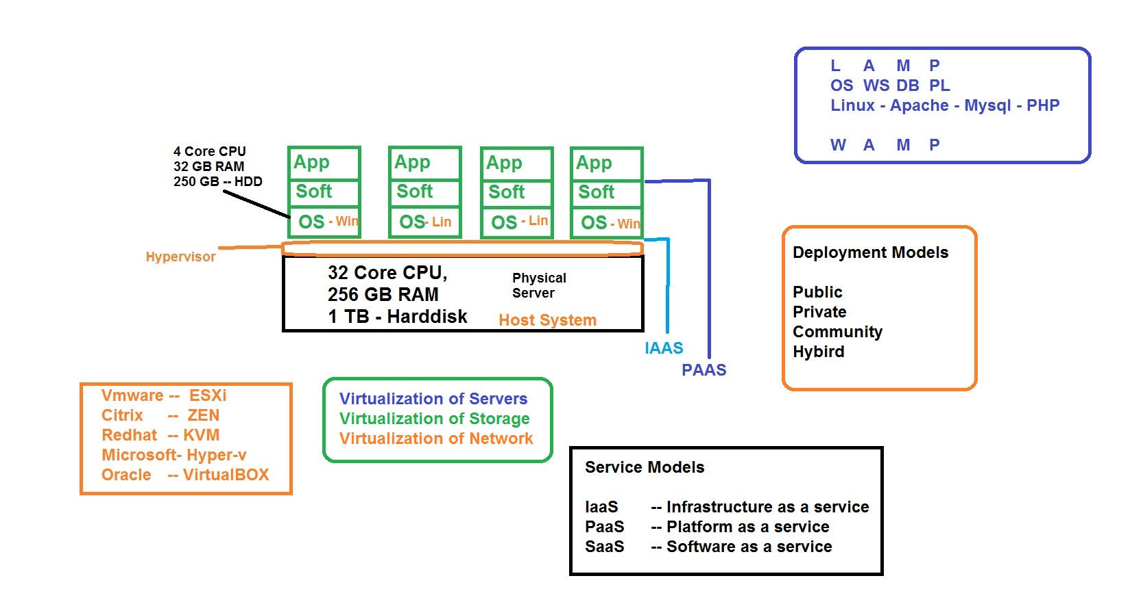

Slide 47
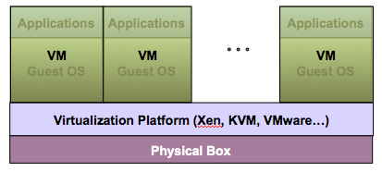
Virtualization Architecture
A Virtual machine (VM) is an isolated runtime environment (guest OS and applications)
Multiple virtual systems (VMs) can run on a single physical system

Slide 48
Hypervisor
A hypervisor, a.k.a. a virtual machine manager/monitor (VMM), or virtualization manager, is a program that allows multiple operating systems to share a single hardware host.
Each guest operating system appears to have the host's processor, memory, and other resources all to itself. However, the hypervisor is actually controlling the host processor and resources, allocating what is needed to each operating system in turn and making sure that the guest operating systems (called virtual machines) cannot disrupt each other.

Slide 49
Benefits of Virtualization
Sharing of resources helps cost reduction
Isolation: Virtual machines are isolated from each other as if they are physically separated
Encapsulation: Virtual machines encapsulate a complete computing environment
Hardware Independence: Virtual machines run independently of underlying hardware
Portability: Virtual machines can be migrated between different hosts.

Slide 50
Virtualization in Cloud Computing
Cloud computing takes virtualization one step further:
You don’t need to own the hardware
Resources are rented as needed from a cloud
Various providers allow creating virtual servers:
  Choose the OS and software each instance will have
  The chosen OS will run on a large server farm
  Can instantiate more virtual servers or shut down existing ones within minutes
You get billed only for what you used

Slide 51
Cloud Computing Agenda
What is Cloud Computing ?
  Different perspectives
  Properties and characteristics
  Benefits from cloud computing
Service and deployment models
  Three service models
  Four deployment models

Slide 52

Service Models
Choose the service you need.

Slide 53

A Simple Analogy
Say, you just moved to a city and you are looking for a place to live.

Slide 54

What is your choice ?
Built a new house ?
Buy an empty house ?
Live in a hotel ?

Slide 55
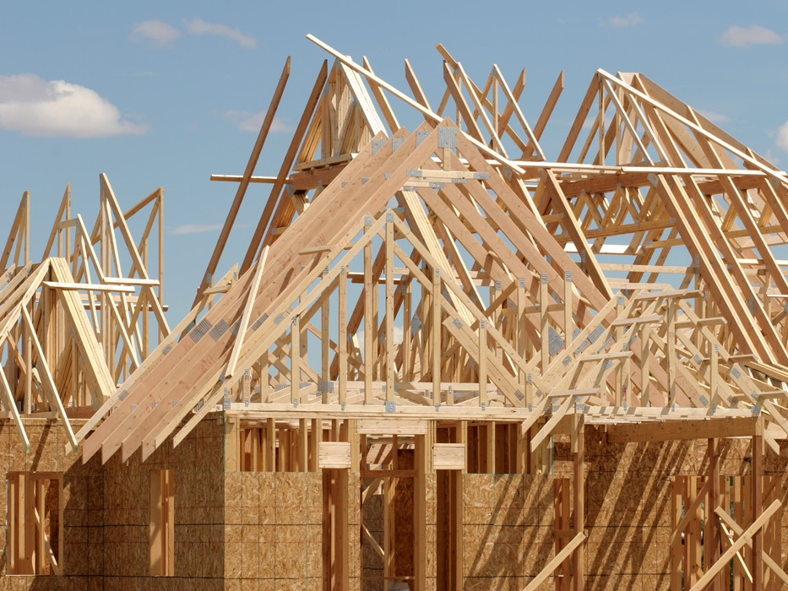
Let’s built a new house !!
You can fully control everything your like your new house to have. But that is a hard work …

Slide 56

If you buy an empty house ?
You can customize some part of your house. But never change the original architecture.

Slide 57

How about live in a hotel ?
Live in a hotel will be a good idea if the only thing you care is enjoy your life!! There is nothing you can do with the house except living in it.

Slide 58
Let’s translate to
Cloud Computing !!

Slide 59
Service Models Overview
What if you want to have an IT department ?
  Similar to build a new house in previous analogy
    You can rent some virtualized infrastructure and build up your own IT system among those resources, which may be fully controlled.
    Technical speaking, use the Infrastructure as a Service (IaaS) solution.
  Similar to buy an empty house in previous analogy
    You can directly develop your IT system through one cloud platform, and do not care about any lower level resource management.
    Technical speaking, use the Platform as a Service (PaaS) solution.
  Similar to live in a hotel in previous analogy
    You can directly use some existed IT system solutions, which were provided by some cloud application service provider, without knowing any detail technique about how these service was achieved.
    Technical speaking, use the Software as a Service (SaaS) solution.

Slide 60
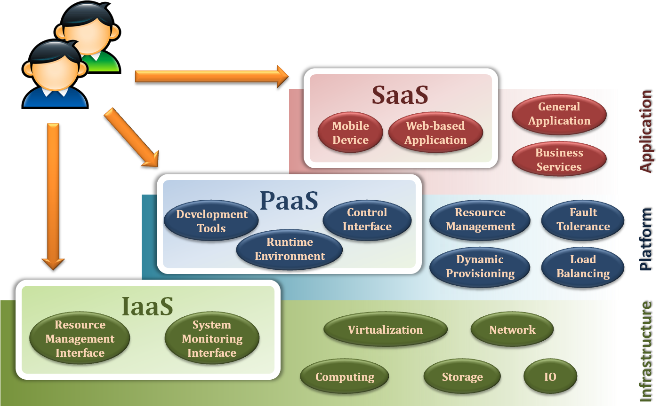
Service Model Overview

Slide 61
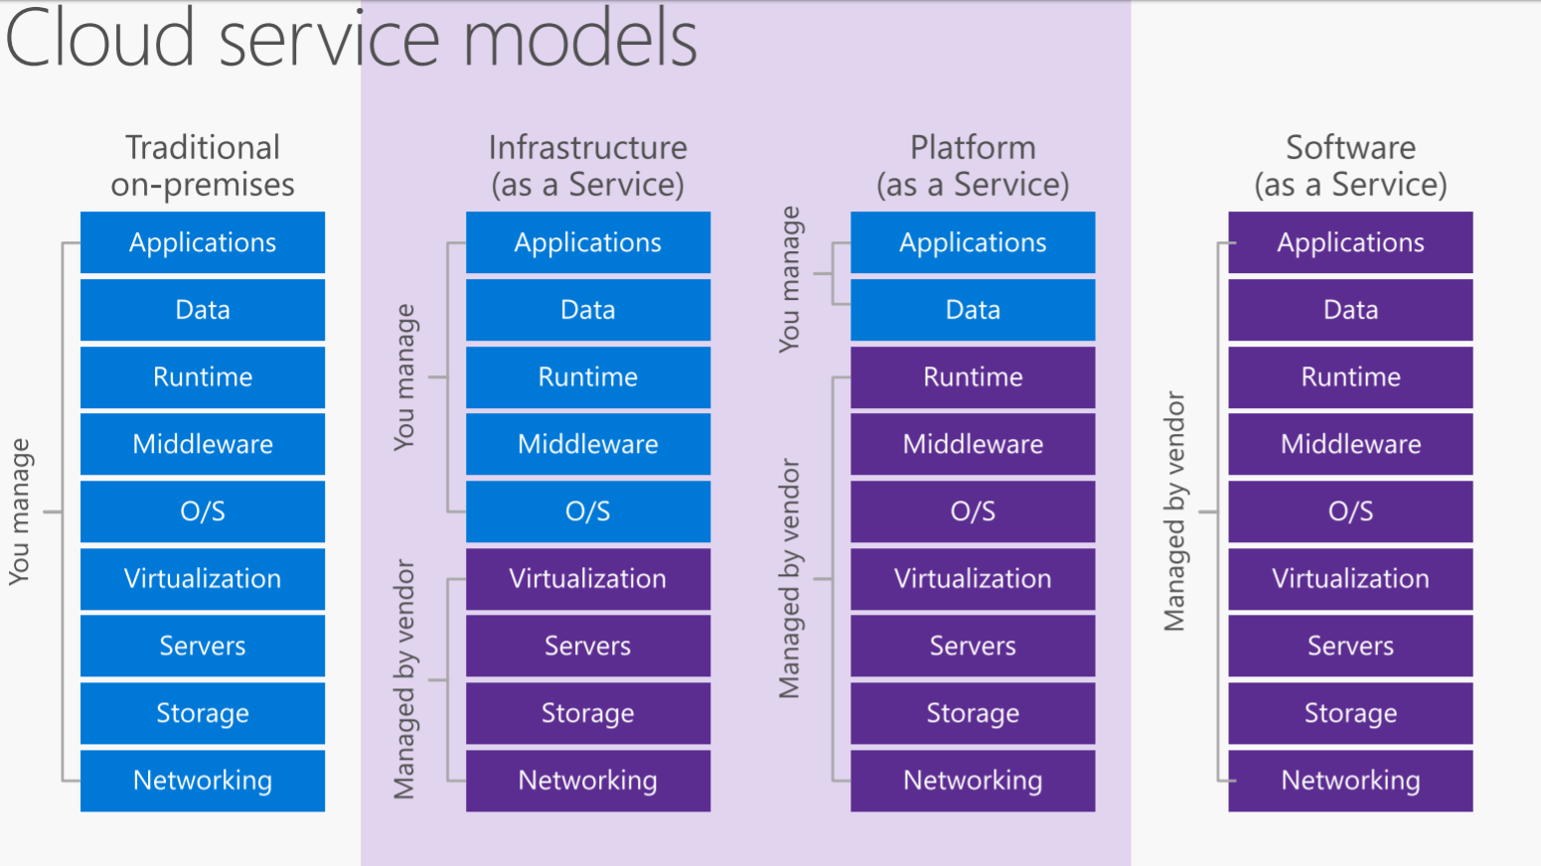
Cloud Service Models

Slide 62
Service Models
Infrastructure as a Service
Platform as a Service
Software as a Service

Slide 63
Infrastructure as a Service
Infrastructure as a Service - IaaS
  The capability provided to the consumer is to provision processing, storage, networks, and other fundamental computing resources where the consumer is able to deploy and run arbitrary software, which can include operating systems and applications.
  The consumer does not manage or control the underlying cloud infrastructure but has control over operating systems, storage, deployed applications, and possibly limited control of select networking components .
Examples :
  Amazon EC2
  Eucalyputs
  OpenNebula
  … etc

Slide 64
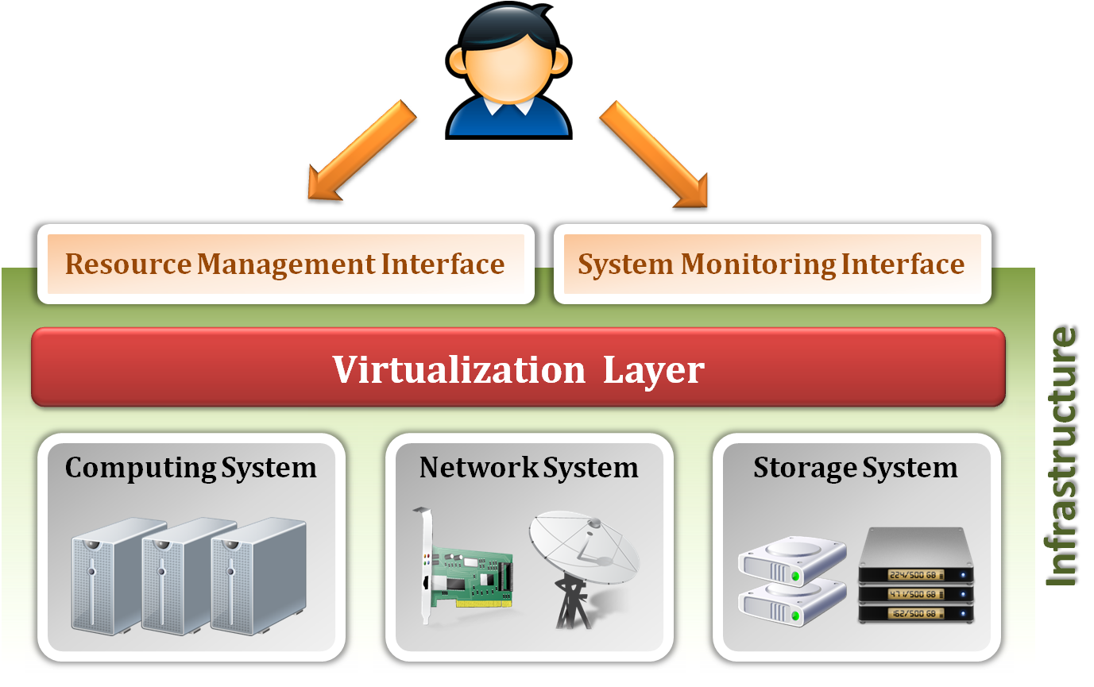
Infrastructure as a Service
System architecture :

Slide 65
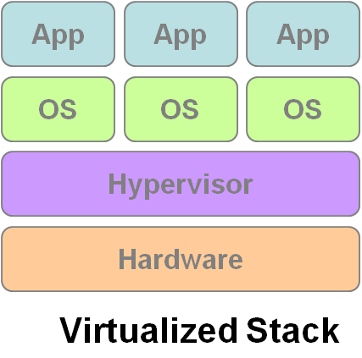
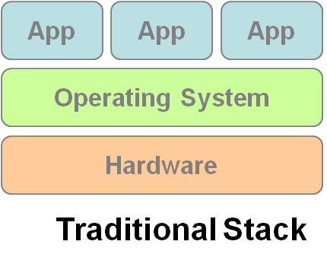
Infrastructure as a Service
Enabling technique - Virtualization
  Virtualization is an abstraction of logical resources away from underlying physical resources.
    Virtualization technique shift OS onto hypervisor.
    Multiple OS share the physical hardware and provide different services.
    Improve utilization, availability, security and convenience.
VM1
VM2
VM3

Slide 66
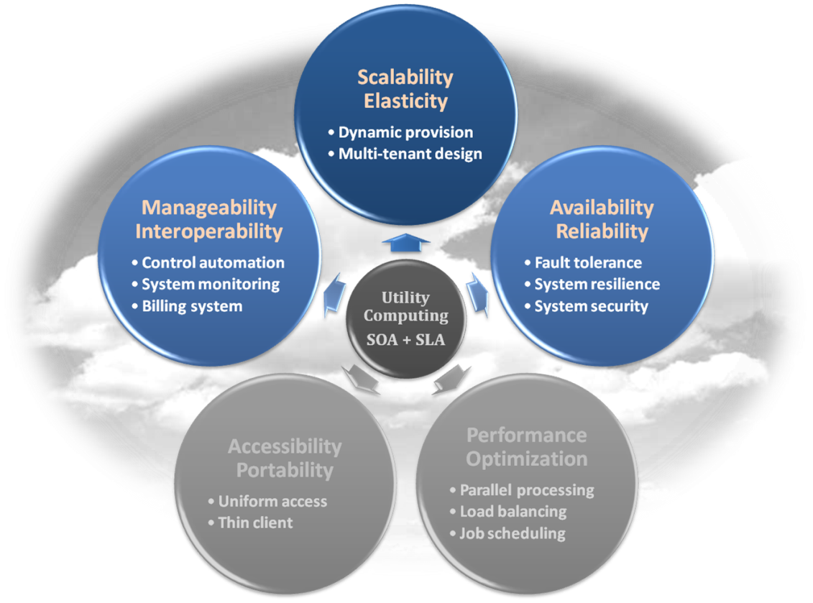
Infrastructure as a Service
Properties supported by virtualization technique :
  Manageability and Interoperability
  Availability and Reliability
  Scalability and Elasticity

Slide 67
Infrastructure as a Service
Provide service –Resource Management Interface
  Several types of virtualized resource :
    Virtual Machine – As an IaaS provider, we should be able to provide the basic virtual machine operations, such as creation, suspension, resumption and termination, …etc.
    Virtual Storage – As an IaaS provider, we should be able to provide the basic virtual storage operations, such as space allocation, space release, data writing and data reading, …etc.
    Virtual Network – As an IaaS provider, we should be able to provide the basic virtual network operations, such as IP address allocation, domain name register, connection establishment and bandwidth provision, …etc.

Slide 68
Infrastructure as a Service
Provide service – System Monitoring Interface
  Several types of monitoring metrics :
    Virtual Machine – As an IaaS provider, we should be able to monitor some system states of each virtual machine, such as CPU loading, memory utilization, IO loading and internal network loading, …etc.
    Virtual Storage – As an IaaS provider, we should be able to monitor some storage states of each virtual storage, such as virtual space utilization, data duplication and storage device access bandwidth, …etc.
    Virtual Network – As an IaaS provider, we should be able to monitor some network states of each virtual network, such as virtual network bandwidth, network connectivity and network load balancing, …etc.

Slide 69
IaaS - Summary
IaaS is the deployment platform that abstract the infrastructure.
IaaS enabling technique
  Virtualization
    Server Virtualization
    Storage Virtualization
    Network Virtualization
IaaS provided services
  Resource Management Interface
  System Monitoring Interface

Slide 70
Service Models
Infrastructure as a Service
Platform as a Service
Software as a Service

Slide 71
Platform as a Service
Platform as a Service - PaaS
  The capability provided to the consumer is to deploy onto the cloud infrastructure consumer-created or acquired applications created using programming languages and tools supported by the provider.
  The consumer does not manage or control the underlying cloud infrastructure including network, servers, operating systems, or storage, but has control over the deployed applications and possibly application hosting environment configurations.
Examples :
  Microsoft Windows Azure
  Google App Engine
  Hadoop
  … etc

Slide 72
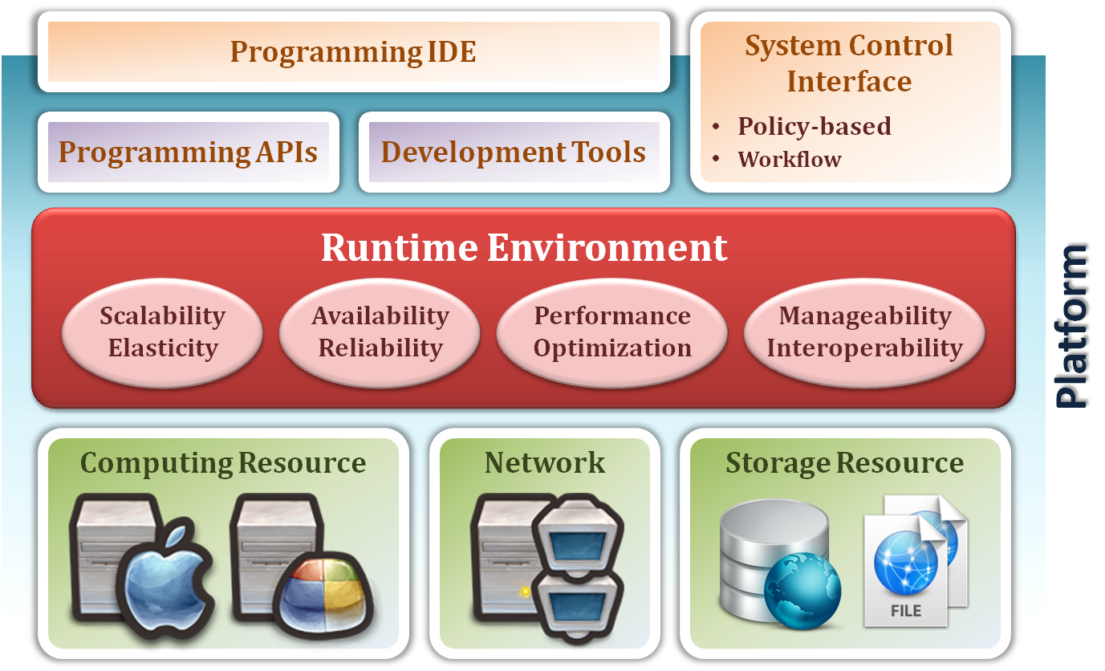
Platform as a Service
System architecture :

Slide 73
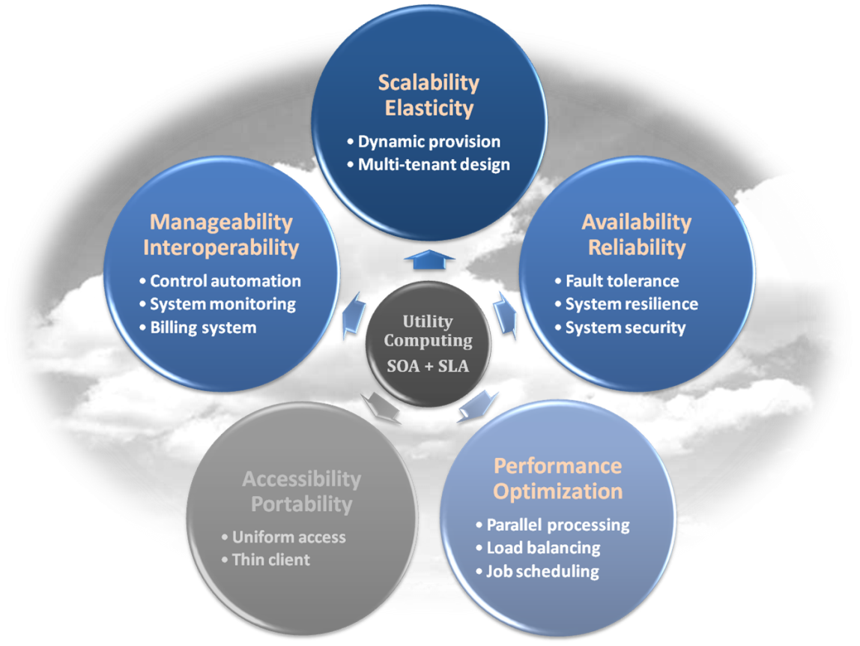
Platform as a Service
Enabling technique – Runtime Environment Design
  Runtime environment refers to collection of software services available. Usually implemented by a collection of program libraries.
Common properties in Runtime Environment :
  Manageability and Interoperability
  Performance and Optimization
  Availability and Reliability
  Scalability and Elasticity

Slide 74
PaaS - Summary
PaaS is the development platform that abstract the infrastructure, OS, and middleware to drive developer productivity.
PaaS enabling technique
  Runtime Environment
PaaS provide services
  Programming IDE
    Programming APIs
    Development tools
  System Control Interface
    Policy based approach
    Workflow based approach

Slide 75
Service Models
Infrastructure as a Service
Platform as a Service
Software as a Service

Slide 76
Software as a Service
Software as a Service - SaaS
  The capability provided to the consumer is to use the provider’s applications running on a cloud infrastructure. The applications are accessible from various client devices through a thin client interface such as a web browser (e.g., web-based email).
  The consumer does not manage or control the underlying cloud infrastructure including network, servers, operating systems, storage, or even individual application capabilities, with the possible exception of limited user-specific application configuration settings.
Examples :
  Google Apps (e.g., Gmail, Google Docs, Google sites, …etc)
  SalesForce.com
  EyeOS
  … etc

Slide 77
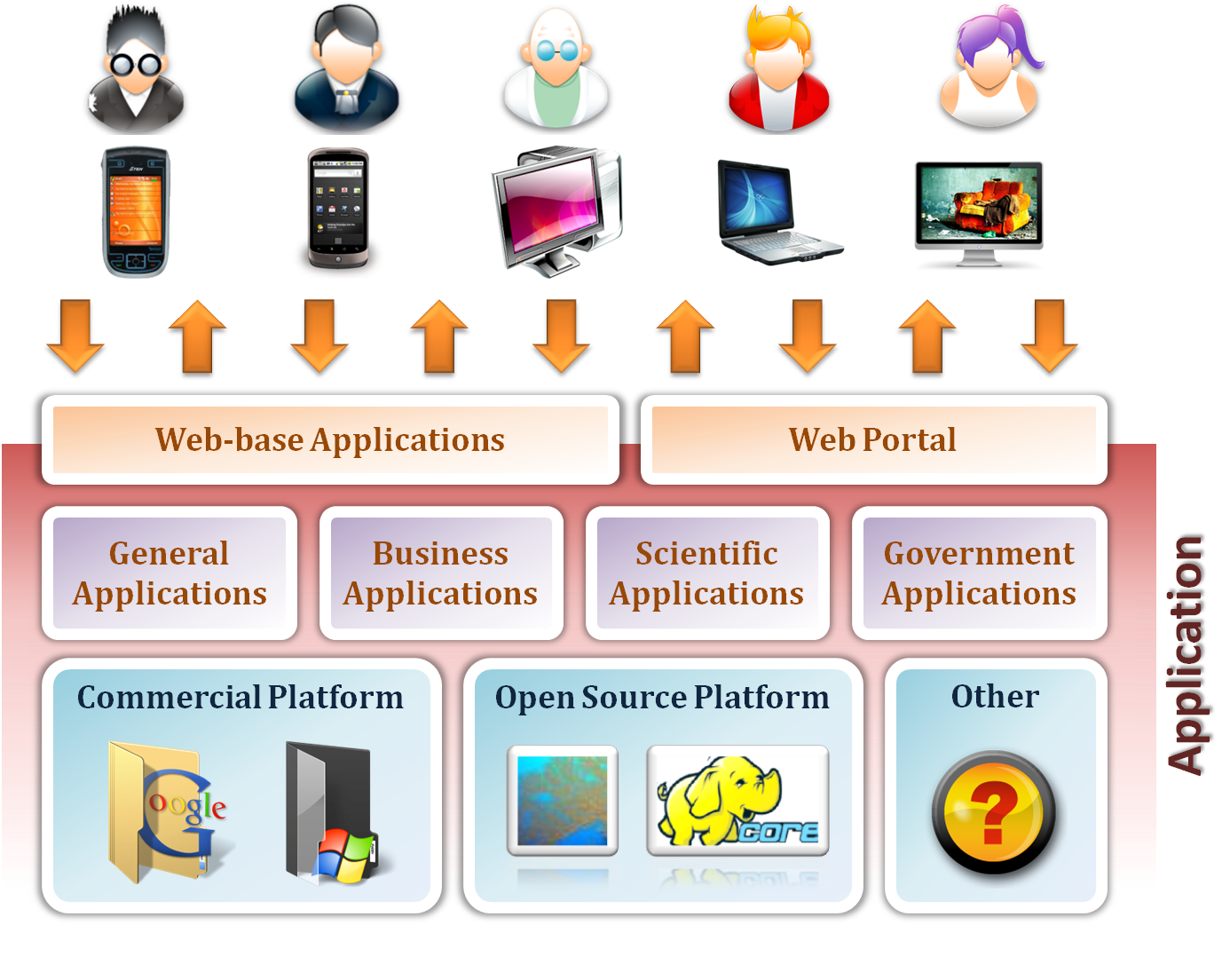
Software as a Service

Slide 78
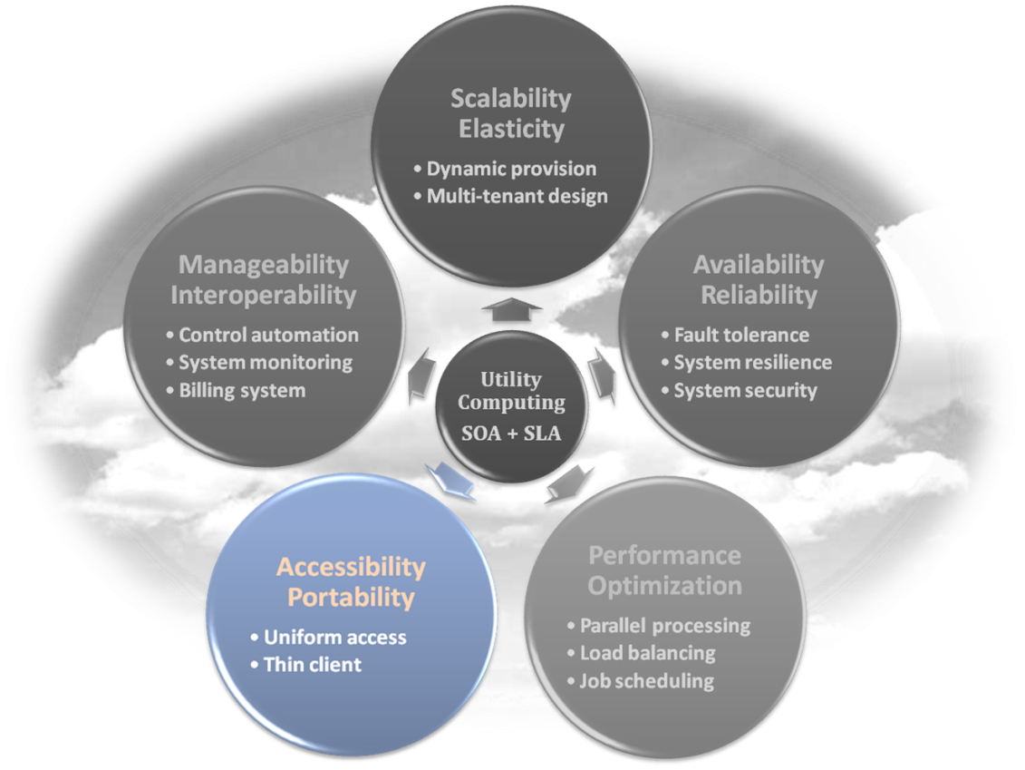
Software as a Service
Enabling Technique – Web Service
  Web 2.0 is the trend of using the full potential of the web
    Viewing the Internet as a computing platform
    Running interactive applications through a web browser
    Leveraging interconnectivity and mobility of devices
    Enhanced effectiveness with greater human participation
Properties provided by Internet :
  Accessibility and Portability

Slide 79
Software as a Service
Provide service – Web-based Applications
  Conventional applications should translate their access interface onto web-based platform.
  Applications in different domains
    General Applications – Applications which are designed for general propose, such as office suit, multimedia and instant message, …etc.
    Business Applications – Application which are designed for business propose, such as ERP, CRM and market trading system, …etc.
    Scientific Applications – Application which are designed for scientific propose, such as aerospace simulation and biochemistry simulation, …etc.
    Government Applications – Applications which are designed for government propose, such as national medical system and public transportation system service, …etc.

Slide 80
SaaS - Summary
SaaS is the finished applications that you rent and customize.
SaaS enabling technique
  Web Service
SaaS provide services
  Web-based Applications
    General applications
    Business applications
    Scientific applications
    Government applications
  Web Portal

Slide 81

Deployment models
How to deploy a cloud system ?

Slide 82
Deployment Model
There are four primary cloud deployment models :
  Public Cloud
  Private Cloud
  Community Cloud
  Hybrid Cloud
Each can exhibit the previously discussed characteristics; their differences lie primarily in the scope and access of published cloud services, as they are made available to service consumers.

Slide 83
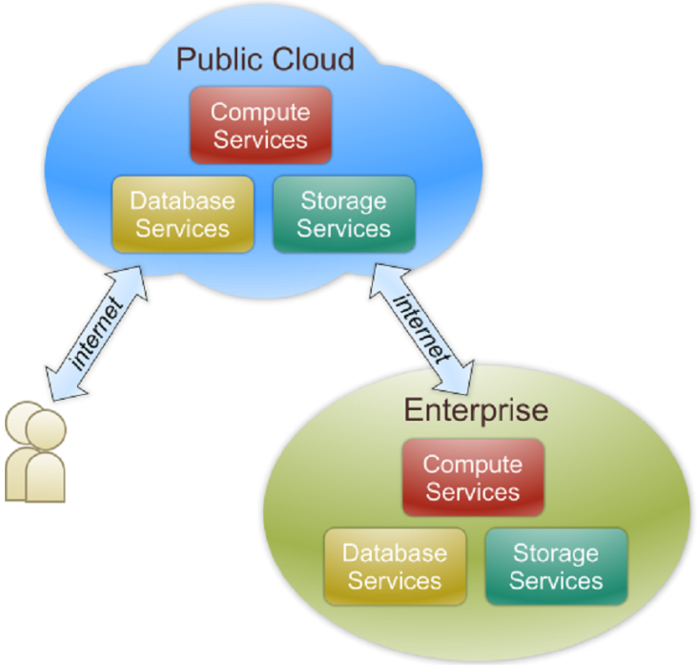
Public Cloud
Public cloud definition
  The cloud infrastructure is made available to the general public or a large industry group and is owned by an organization selling cloud services.
  Also known as external cloud or multi-tenant cloud, this model essentially represents a cloud environment that is openly accessible.
  Basic characteristics :
    Homogeneous infrastructure
    Common policies
    Shared resources and multi-tenant
    Leased or rented infrastructure
    Economies of scale

Slide 84
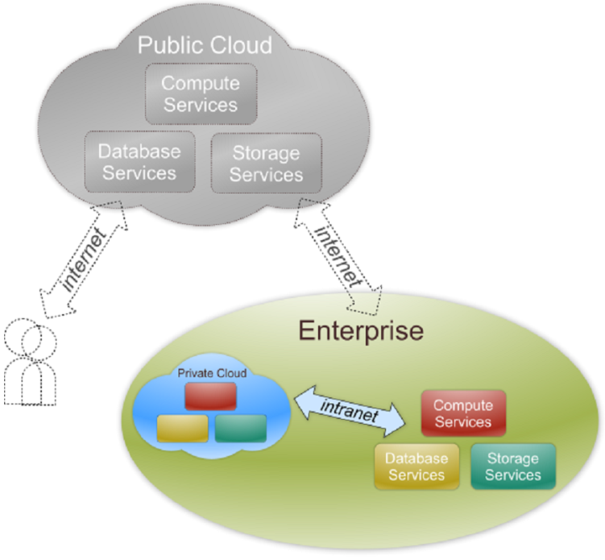
Private Cloud
Private cloud definition
  The cloud infrastructure is operated solely for an organization. It may be managed by the organization or a third party and may exist on premise or off premise.
  Also referred to as internal cloud or on-premise cloud, a private cloud intentionally limits access to its resources to service consumers that belong to the same organization that owns the cloud.
  Basic characteristics :
    Heterogeneous infrastructure
    Customized and tailored policies
    Dedicated resources
    In-house infrastructure
    End-to-end control

Slide 85
Public vs. Private
Comparison :
 | Public Cloud | Private Cloud
Infrastructure | Homogeneous | Heterogeneous
Policy Model | Common defined | Customized & Tailored
Resource Model | Shared & Multi-tenant | Dedicated
Cost Model | Operational expenditure | Capital expenditure
Economy Model | Large economy of scale | End-to-end control

Slide 86
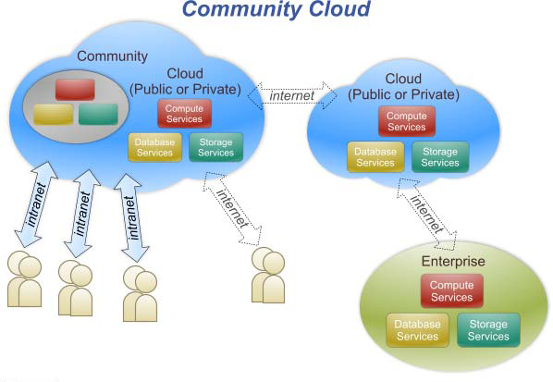
Community Cloud
Community cloud definition
  The cloud infrastructure is shared by several organizations and supports a specific community that has shared concerns (e.g., mission, security requirements, policy, and compliance considerations).

Slide 87
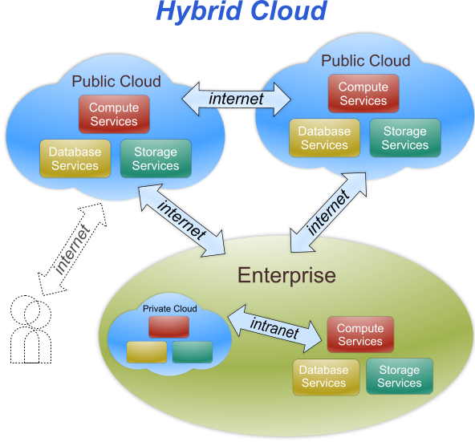
Hybrid Cloud
Hybrid cloud definition
  The cloud infrastructure is a composition of two or more clouds (private, community, or public) that remain unique entities but are bound together by standardized or proprietary technology that enables data and application
  portability (e.g., cloud bursting
  for load-balancing between
  clouds).

Slide 88
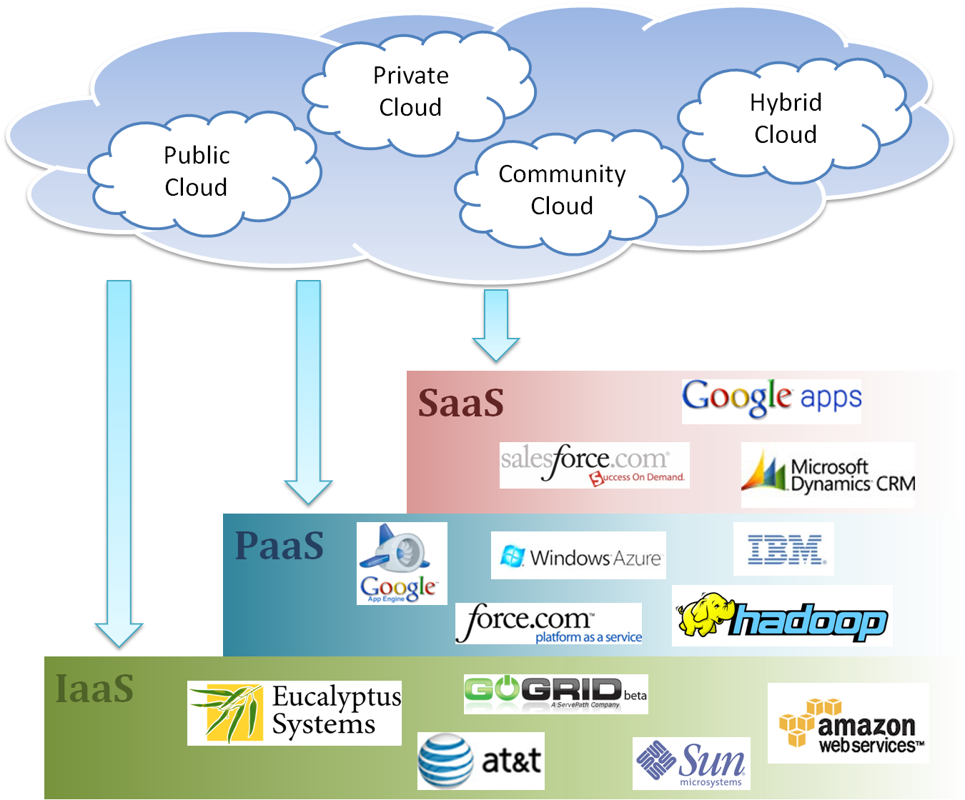
Cloud Ecosystem

Slide 89
Summary
What is cloud computing in your mind
  Clear or Cloudy?
Cloud computing is a new paradigm shift of computing
Cloud computing can provide high quality of properties and characteristics based on essentially central ideas
Service models and deployment models provide services that can be used to
  Rent fundamental computing resources
  Deploy and develop customer-created applications on clouds
  Access provider’s applications over network (wired or wireless)

Slide 90
References
NIST (National Institute of Standards and Technology). http://csrc.nist.gov/groups/SNS/cloud-computing/
M. Armbrust et. al., “Above the Clouds: A Berkeley View of Cloud Computing,” Technical Report No. UCB/EECS-2009-28, University of California at Berkeley, 2009.
R. Buyya et. al., “Cloud computing and emerging IT platforms: Vision, hype, and reality for delivering computing as the 5th utility,” Future Generation Computer Systems, 2009.
Cloud Computing Use Cases. http://groups.google.com/group/cloud-computing-use-cases
Cloud Computing Explained. http://www.andyharjanto.com/2009/11/wanted-cloud-computing-explained-in.html
From Wikipedia, the free encyclopedia
All resources of the materials and pictures were partially retrieved from the Internet.

